Slide 1

Database Management System - An Efficient Way to Store and Manage Data
Presented by:
N. UDAY KIRAN (192473001)
CSA0506 : DATABASE MANAGEMENT SYSTEM
Date: 21/07/2026
Technical Presentation

Slide 2
Introduction
DBMS stands for Database Management System. It is software used to create, store, organize, retrieve, and manage data efficiently. It acts as a bridge between the user and the database, making data access simple, secure, and reliable.
Some popular examples of DBMS are MySQL, Oracle Database, and Microsoft SQL Server.
The main objectives of a DBMS are to store large amounts of data securely, reduce duplicate data, retrieve information quickly, maintain data consistency, support multiple users at the same time, and provide data security along with backup and recovery.

Slide 3
Working & Functions
How DBMS Works:
User
│
▼
Application
│
▼
Database Management
System (DBMS)
│
▼
Database
│
▼
Requested Information
Returned to User
Main Functions of DBMS:
Data Storage – Stores data in an organized and secure manner.
Data Retrieval – Retrieves required information quickly using queries.
Data Update – Allows adding, modifying, or deleting records.
Data Security – Protects data through authentication and access control.
Backup & Recovery – Restores data in case of system failure or data loss.
Transaction Management – Ensures transactions are completed accurately while maintaining data consistency.

Slide 4
Advantages of DBMS
Data Security
Protects sensitive data using authentication, authorization, and access control.
Reduced Data Redundancy
Eliminates duplicate data, saving storage space and improving efficiency.
Data Integrity
Ensures data remains accurate, consistent, and reliable.
Multi-User Access
Allows multiple users to access and work with the database simultaneously.
Backup & Recovery
Provides backup facilities and restores data in case of failures or data loss.
Efficient Data Sharing
Enables authorized users to share and access data quickly and securely.

Slide 5
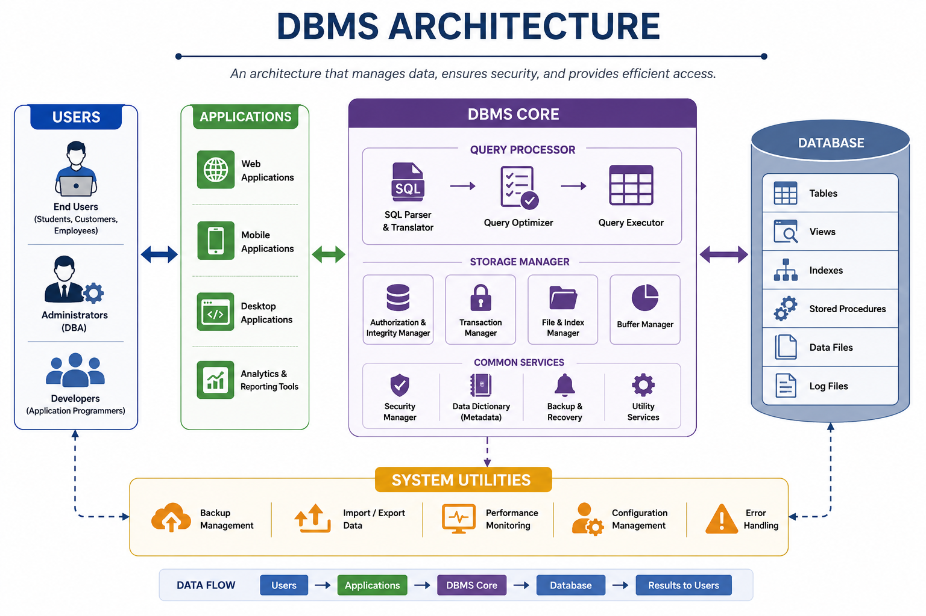
Architecture Diagram

Slide 6
Real-World Applications & Conclusion
Banking
Customer accounts
Online transactions
Healthcare
Patient records
Hospital management
Education
Student database
Examination systems
E-Commerce
Product inventory
Online orders
Railway/Airline Reservation
Ticket booking
Seat management

Slide 7
Conclusion
DBMS is essential for efficient data management.
It improves security, consistency, and accessibility of data.
It is widely used in banking, healthcare, education, e-commerce, and many other industries.
DBMS plays a vital role in modern information systems.

Slide 8


Thank You!!!

